Slide 1
CHAPTER 2
TEXT
REPRESENTATION

Slide 2



REVIEW
10MIN
?
OVERFLOW ERROR
What is the difference between :
ROUNDING ERROR
Give examples in both cases

Slide 3
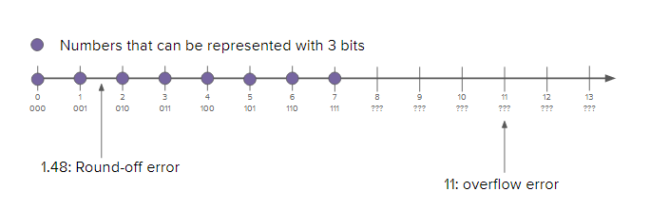
REVIEW
OVERFLOW ERROR
05 MIN
Error from attempting to represent a number that is too large.
ROUNDING ERROR
Error from attempting to represent a number that is too precise. The value is rounded.

Slide 4
PRACTICE
Using only numbers, you will need to communicate a message to your partner.
No letters or characters allowed!
15 MIN
TEAM 2
Define together a system that allow you to do this
Example of messages you will need to communicate :
hey
ttyl
morning

Slide 5
CHALLENGE 1
MEMBER 1
MEMBER 2
Use your system to encode the secret message 1
Write it on paper - send it to your partner
Use your system to translate the message on paper
Check the result is equal to the initial message

Slide 6
CHALLENGE 2
MEMBER 1
MEMBER 2
Use your system to encode the secret message 2
Write it on paper - send it to your partner
Use your system to translate the message on paper
Check the result is equal to the initial message

Slide 7
CHALLENGE 3
MEMBER 1
MEMBER 2
Use your system to encode the secret message 3
Write it on paper - send it to your partner
Use your system to translate the message on paper
Check the result is equal to the initial message

Slide 8
REVIEW
5 MIN
Compare other group systems
How are they the same? How are they different?
What's the minimum number of bits each of your systems would need per character?

Slide 9

DISCUSS
LOOK AT YOUR KEYBOARD
05 MNI
what are the possible values for a character?

Slide 10
DISCUSS
LOOK AT YOUR KEYBOARD
05 MNI
what are the possible values for a character ?
- alphabet
- upper / lower case
- numbers
- special characters
- white characters
- ENTER, CONTROL keys, arrow keys

Slide 11
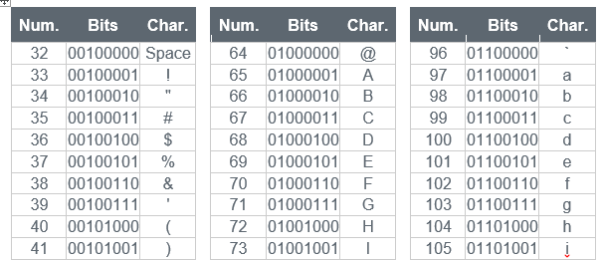
DISCUSS
THIS IS THE ASCII CODE !
05 MNI
INDIVIDUALY
Read the ASCII code table
Take some time to understand it
CLASS DISCUSSIONS
What's the same as the systems you created?
What's different?
What is most interesting or surprising about this system?

Slide 12
PRACTICE
Using the ASCII conversion chart (see handout)
05 MIN
INDIV
Q1 - What is the hexadecimal representation for the string "Hello"?
Q2 - What is the binary representation for the string "Hello"?
Q3 - Convert this binary to hexadecimal and then to ASCII stri g
01000011 01001111 01001101 01010000 00100000 00110001 00110000 00110111 00100001

Slide 13
CHALLENGE 1
MEMBER 1
MEMBER 2
Think about a short sentence
Encode it in binary, using your ASCII table
Give the paper to your partner
Decode the binary to string
Reply to your partner in the same way
Try to communicate together using binary code!!!

Slide 14

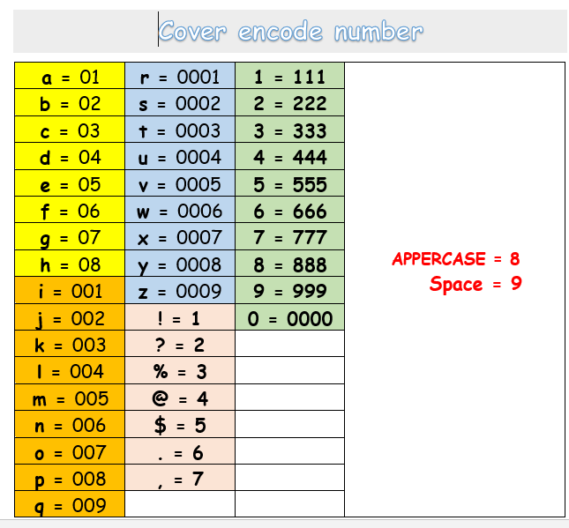
HOMEWORK
Find 3 bugs at least related to this system
Bug example
111 Can be 1 or !!!
INDIV

Slide 15

HOMEWORK
Search activity
INDIV
What is UTF and especially UTF-8?
Be ready to explain to others for the next session

